Slide 1


LAYOUT TECHNIQUES IN CSS

Slide 2
Flexbox, Grid, Containers, and Wrappers
In modern web development, layout techniques are essential in designing responsive, organized, and user-friendly interfaces. Among the most powerful layout systems in CSS are Flexbox and Grid, often used alongside containers and wrappers to control and structure web page elements.

Slide 3
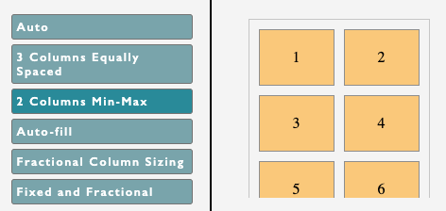
CSS GRIDS
CSS Grid Layout is used to design responsive web layouts with rows and columns. It allows you to place items exactly where you want, making it easier to create flexible and modern web pages.
Unlike older methods like floats, CSS Grid gives more control over alignment and adapts well to different screen sizes.

Slide 4
The .grid-container uses display: grid; to define a grid layout with two columns (grid-template-columns: auto auto;) and a 10px gap between items.
ITEM 1
ITEM 2
.grid-container {
display: grid;
grid-template-columns: auto auto;
gap: 10px;
}
.grid-item{
outline: 1px solid black;
}
ITEM 3
ITEM 4

Slide 5
CSS Grid Layout Properties
Property | Description
column-gap | Defines the amount of space between columns in a multi-column layout, often used with column-count in CSS Grid.
gap | Specifies the spacing (also called gutter) between rows and columns in CSS Grid and Flexbox layouts.
grid | A grid-based layout system in CSS that provides rows and columns, simplifying the design without using floats or positioning.
grid-area | Defines the size and location of a grid item within a CSS grid layout by specifying the start and end lines.
grid-auto-columns | Sets the size of columns that are automatically generated in a CSS Grid layout when more content is added.
grid-auto-flow | It specifies exactly how auto-placed items get flow into the grid.
grid-auto-rows | It is used to specify the size for the rows of implicitly generated grid containers.
grid-column | It describes the number of properties that allow to design of grid structures and control the placement of grid items using CSS.
grid-column-end | It explains the number of columns an item will span, or on which column-line the item will end.
grid-column-gap | It is used to set the size of the gap between the columns in a grid layout.
grid-column-start | It defines for which column line item will start.

Slide 6
CSS Grid Layout Properties
grid-gap | It is used to sets the size of the gap between the rows and columns in a grid layout.
grid-row | It is used to specify the size and location in a grid layout.
grid-row-end | It is used to define the grid item's end position within a grid row by specifying the inline edge of its grid area.
grid-row-gap | It is used to define the size of the gap between the grid elements.
grid-row-start | It is used to define the grid items' start position within the grid row by specifying the inline start edge of its grid area.
grid-template | It is a shorthand property for defining grid columns, rows, and areas.
grid-template-areas | It is used to specify the area within the grid layout.
grid-template-columns | It is used to set the number of columns and size of the columns of the grid.
grid-template-rows | It is used to set the number of rows and height of the rows in a grid.

Slide 7
Example 1 : Three-Column Layout
The .grid-container is set to display as a grid with three equal-width columns (1fr each) and a 10px gap between them.
Col 1
Col 2
Col 3
.grid-container {
display: grid;
grid-template-columns: 1fr 1fr 1fr;
gap: 10px;
}
.grid-item {
background-color: #f0f0f0;
padding: 20px;
text-align: center;
outline: 1px solid red;
}

Slide 8
Example 2: Responsive Three-Row Layout
The .grid-container is defined as a grid with two rows (auto height) and a 15px gap between them.
Row 1
.grid-container {
display: grid;
grid-template-rows: auto auto auto;
gap: 15px;
}
.grid-item {
background-color: #e0e0e0;
padding: 15px;
text-align: center;
outline: 1px solid red;
}
Row 2
Row 3

Slide 9
Example 3: Four-Item Grid with Unequal Column Widths
The .grid-container is defined as a grid with two columns, where the first column takes up one fraction (1fr) of the available space, and the second column takes up two fractions (2fr), creating unequal column widths.
Item 1
Item 2
.grid-container {
display: grid;
grid-template-columns: 1fr 2fr;
gap: 10px;
}
.grid-item {
background-color: #f0f0f0;
padding: 20px;
text-align: center;
outline: 1px solid red;
}
Item 1
Item 2

Slide 10
Best Practices for CSS Grid Layout
Use Flexible Units: Utilize flexible units like fr and minmax() to create responsive layouts that adapt to various screen sizes.
Define Explicit Grid Areas: Clearly specify grid areas using grid-template-areas for better readability and maintainability of your code.
Combine with Other Layout Methods: Integrate CSS Grid with Flexbox to leverage the strengths of both and achieve complex, responsive design
https://www.geeksforgeeks.org/css/css-grid-layout-module/

Slide 11
CSS Flexbox
The Flexible Box Layout module introduces a one-dimensional layout system that handles space distribution and item alignment effectively. It works seamlessly for horizontal (row) or vertical (column) arrangements, making it a go-to solution for responsive designs.
Flexbox eliminates the need for floats or complex positioning, enabling responsive and dynamic layouts.
It aligns items efficiently, distributing space within a container, even when their sizes are dynamic or unknown.
Flexbox is supported in all modern browsers, making it a reliable choice for creating flexible designs.

Slide 12
Key Features of CSS Flexbox
Alignment: Easily aligns items along the main axis (row/column) or cross-axis (perpendicular direction).
Space Distribution: Distributes space among items or gaps dynamically within a container.
Responsive Design: Adapts to screen sizes without extra effort, perfect for modern web layouts.

Slide 13
CSS Flex-box

Slide 14
What is Flex-box?
The Flexible Box Layout module introduces a one-dimensional layout system that handles space distribution and item alignment effectively. It works seamlessly for horizontal (row) or vertical (column) arrangements, making it a go-to solution for responsive designs.

Slide 15
Key Features of CSS Flexbox
Alignment: Easily aligns items along the main axis (row/column) or cross-axis (perpendicular direction).
Space Distribution: Distributes space among items or gaps dynamically within a container.
Responsive Design: Adapts to screen sizes without extra effort, perfect for modern web layouts.

Slide 16
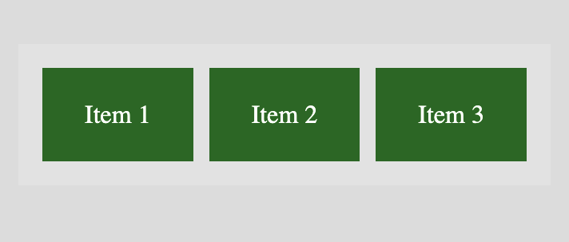
In this Example,
The .flex-container class applies display: flex;, designating the div as a flex container.
.flex-container {
display: flex;
background-color: #f2f2f2;
padding: 10px;
}
.flex-item {
background-color: #4CAF50;
color: white;
margin: 5px;
padding: 20px;
text-align: center;
flex: 1;
}

Slide 17
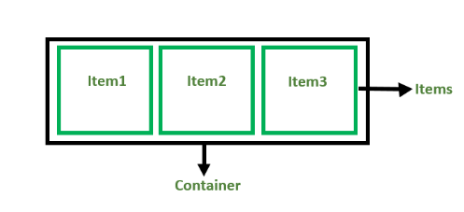
Flexbox Components
Flex Container: The parent div containing various divisions.
Flex Items: The items inside the container div.

Slide 18
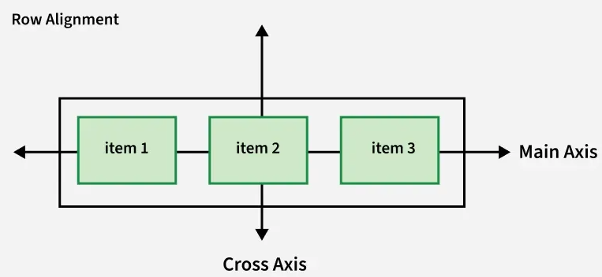
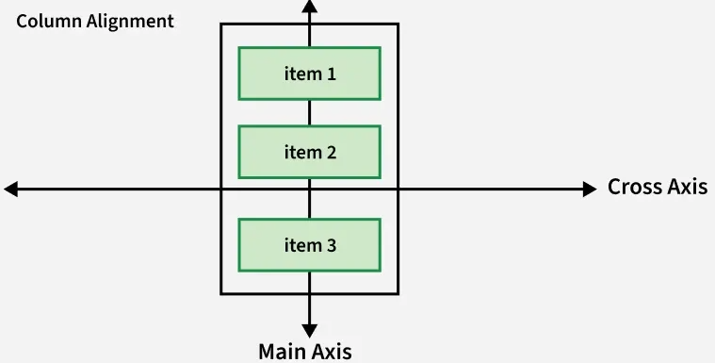
Flexbox Axes
Flexbox operates on two axes:
Main Axis: Runs from left to right by default.
Cross Axis: Perpendicular to the main axis, runs from top to bottom.

Slide 19
Flexbox Axes
Flexbox operates on two axes:
Main Axis: Runs from left to right by default.
Cross Axis: Perpendicular to the main axis, runs from top to bottom.

Slide 20
Arowwai Industries
THANK YOU!
FOR YOUR ATTENTION
www.reallygreatsite.com

